Slide 1

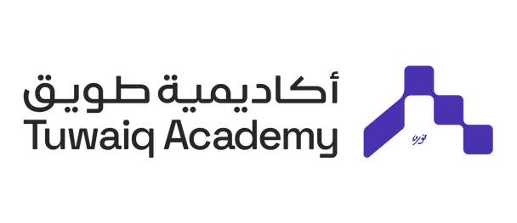

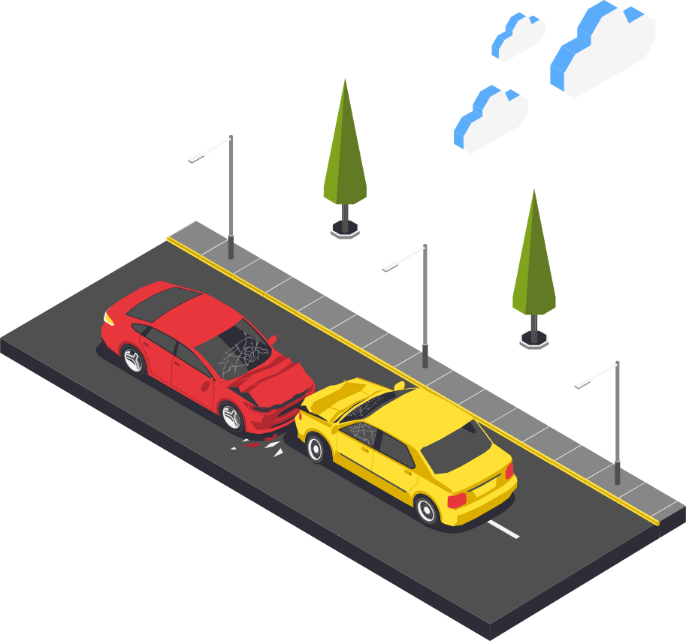

AI Based System For Real-Time Accident Severity Detection
VISION
Nora Alshahrani
Nada Alotaibi
Amal Alqahtani
Lana Alasim

Slide 2
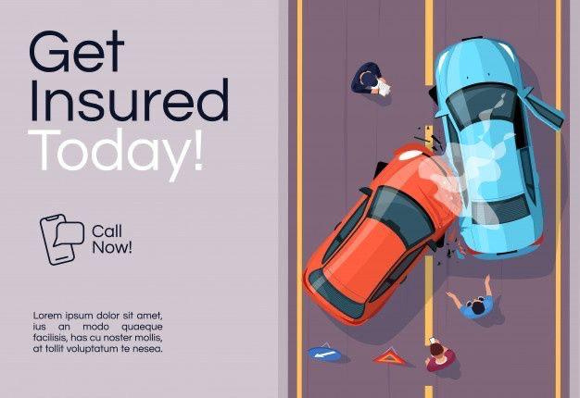
PROBLEM STATEMENT
Delays in detecting and responding to traffic accidents slow emergency response times and increase the risk.
SOLUTION
Develop a real-time traffic accident detection system using street cameras and AI technology. The system will employ YOLOv8 to automatically detect and classify accidents into three severity levels: mild, moderate, and severe. Additionally, it will identify damaged vehicles and fallen individuals for comprehensive incident reporting.

Slide 3


VISION 2030
Traffic Safety Improvement
Advanced Technologies
Economic Growth
"نحن نعيش في عصر الثورة الصناعية الرابعة، وهي ثورة تعتمد على التكنولوجيا والبيانات، وإذا لم نواكب هذه الثورة، سنتأخر كثيرًا عن العالم"

Slide 4
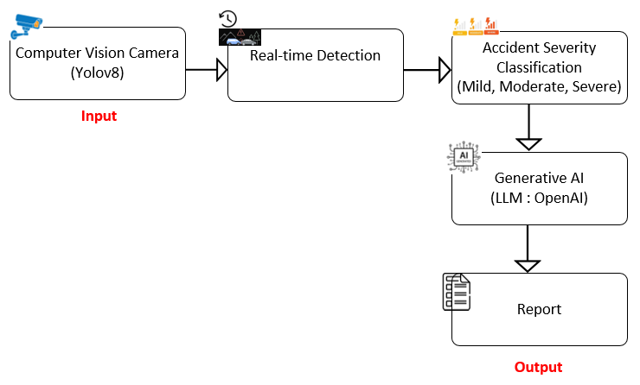
SOLUTION ARCHITECT

Slide 5
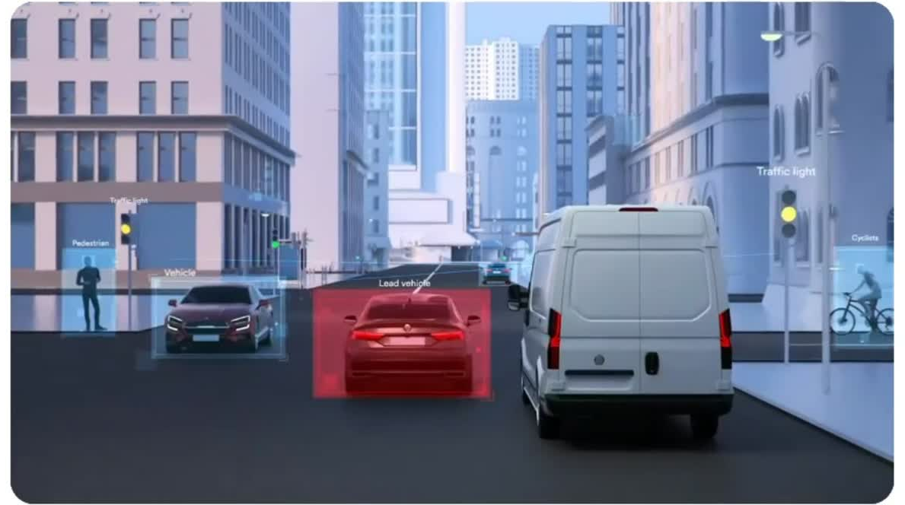


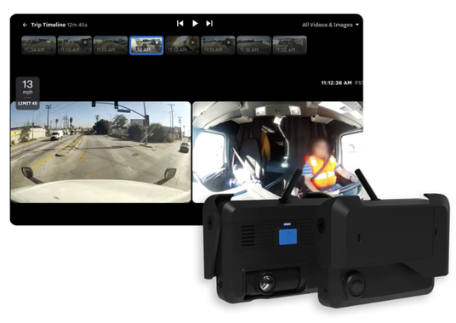
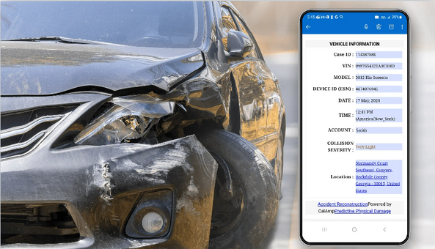


EXISTING SOLUTIONS
These systems offer real-time accident detection using AI to assess severity and automatically send reports to fleet managers or authorities. This enhances road safety by enabling quick responses and accurate incident management.
( )
( )
( )

Slide 6
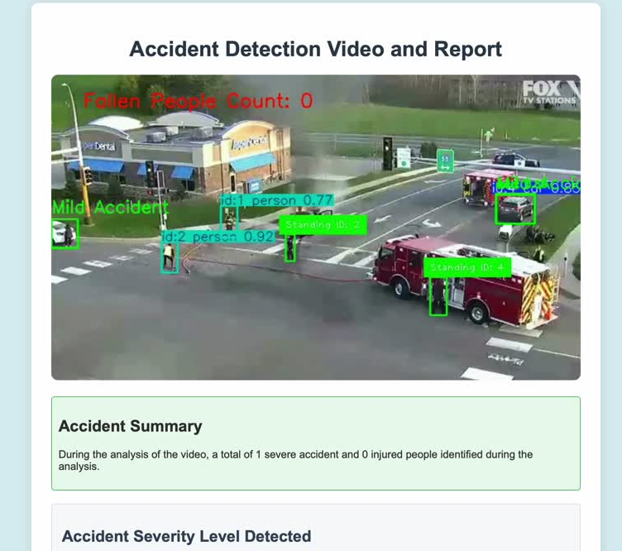
DEMO

